Slide 1
Greedy Snake Based On MIPS CPU
Computer Architecture & Structure Final Report
1452640 Zonglin DI

Slide 2
Outline
The Introduction to my MIPS CPU
Greedy Snake Game & Its Architecture
Project Management
Acknowledgements
Video Show

Slide 3
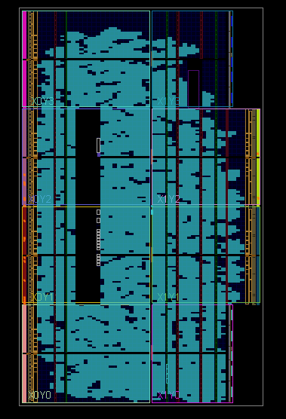
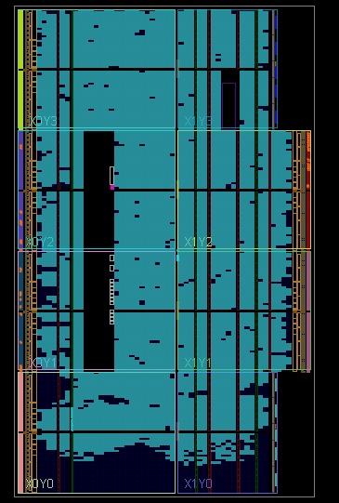
My MIPS CPU
5-stage pipeline CPU
60+ Instruction Implementation
50 MHz
DelaySlot Problem & Starting Address 0x400000 & +4/+8

Slide 4
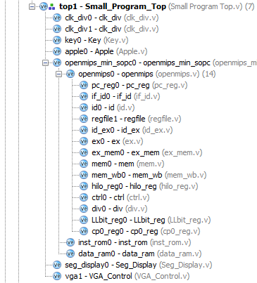
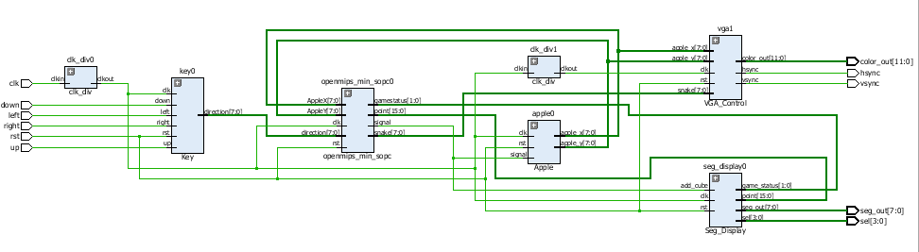
Greedy Snake Game in MIPS

Slide 5
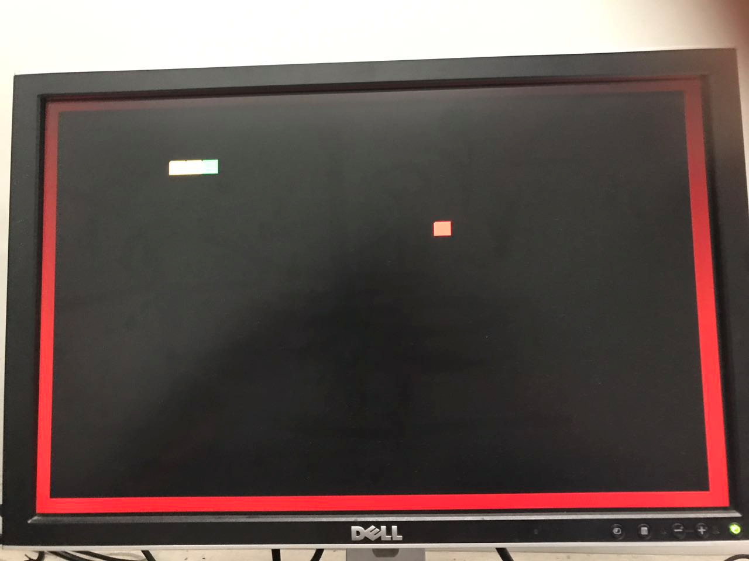
Greedy Snake Game in MIPS
Initialization
All Register Files & Data Memory
Body Position
Play
Direction Control
Hit Wall & Body
Die
Back to Restart
Head Position
Apple Position
Update Body
Eat Apple & Get Points

Slide 6
Main Instructions
beq & bne for scoring and hitting
sw & lw for transition between Regfile and DataMemory
addi, ori and other arithmetic instructions for shifting and updating
bgtz used in comparing the length of body

Slide 7
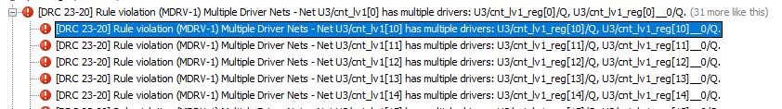
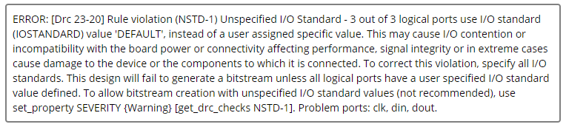
Problems I met and Solutions
Adjust the velocity of the snake according to points

Slide 8
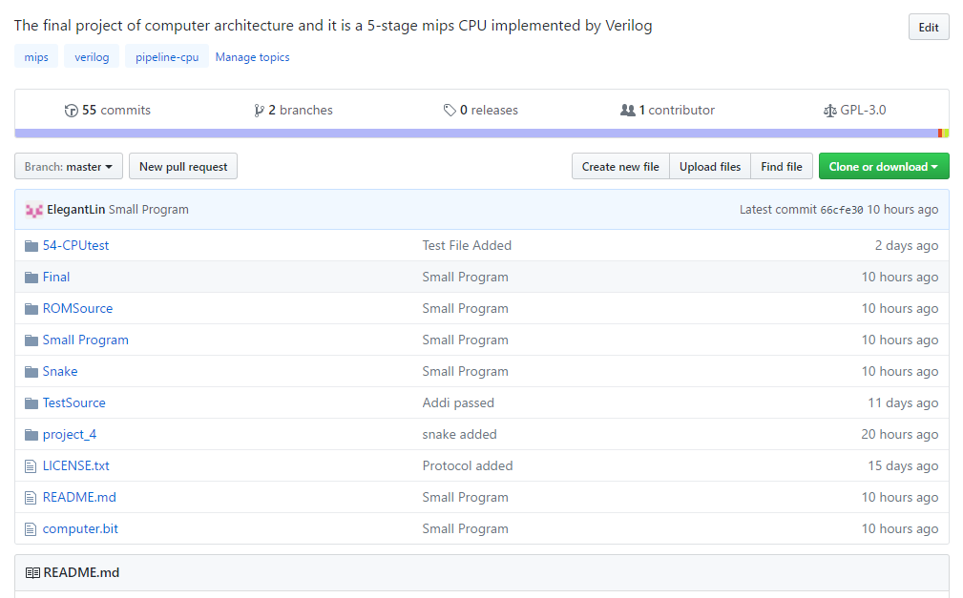
Project Management
https://github.com/ElegantLin/My-CPU

Slide 9
Acknowledgements
Vivado & Verilog: Zijian WANG (CS Junior from Tongji University)
Vivado, Top Test Module & VGA: Hongwei ZHANG (CS Junior from Tongji University)
Exception Instruction Handling: Kun 5.00 (CS Junior from Tongji University)
Audio Suggestion: Jiaqi FAN (CS Junior from Tongji University)
Help and useful advice: Tianchen LIU (CS Junior from Tongji University)
Silei LEI, Write CPU By Yourself 1st version, Sept. 2014, Publishing House Of Electronics History

Slide 10
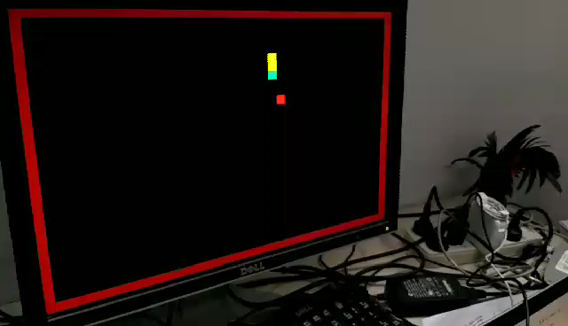
Video Show

Slide 11
Thanks for your listening~
Zonglin
June 17th, 2017 in Tongji University

